Slide 1
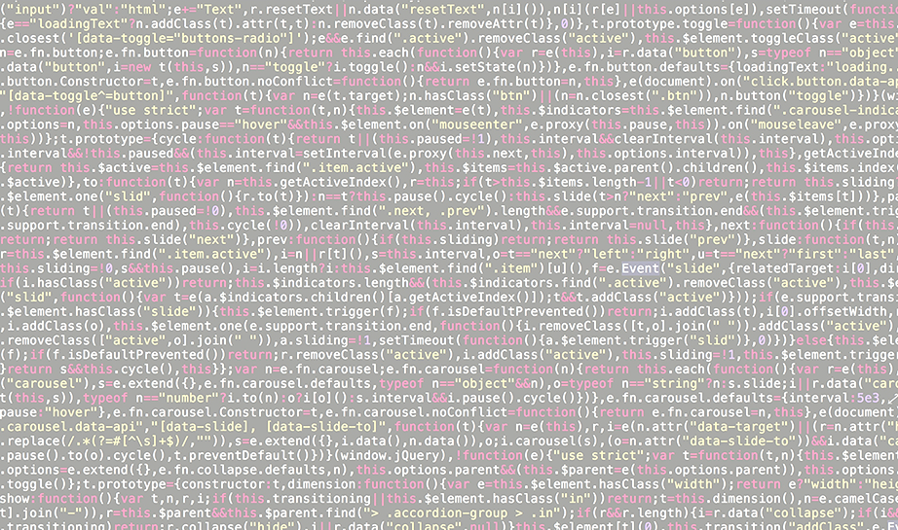














BUILDING CYBER RESILIENCE THROUGH REAL-WORLD TRAINING FOR YOUR CYBER-PROS

Slide 2











About RangeForce
RangeForce was founded in 2015 and is headquartered in Manassas, Virginia. We offer a unique cyber skills simulation platform & cyber range. RangeForce is backed by Energy Impact Partners, Paladin Capital and Cisco. Our founders built the NATO Cyber Range.
OUR CLIENTS

Slide 3








Despite record spend on cybersecurity tools, data breach losses soar into the trillions.
The biggest gap in cybersecurity is the shortage of talent.
Today’s cybersecurity training solutions fail to satisfy the needs of the market.
Cyber range simulations are the most effective but existing versions are not scalable: only available to large banks & government.
$124B
Cybersecurity Tools¹
$2.1T
Est. cost of data breaches²
2.93M
Unfilled cybersecurity jobs³
Traditional e-learning is scalable but not effective or hands-on.
Gartner, August 2018.
Juniper Research, “Cybercrime will cost businesses over $2 trillion by 2019.”
The International Information System Security Certification Consortium (ISC2) study 2019.

Slide 4



RangeForce has built a scalable platform to provide hands-on measurable training for cybersecurity and IT operations professionals
Assess
Learn
Transform
Enroll: Place your users in a 15 - minute role-based assessment. Establish a quantitative baseline and prescribe learning paths that align team skills to cyber risks.
Train: Hundreds of hours of content reflecting the latest environments, security tools, and attacks. Accessible on-demand, anytime, from the cloud with zero latency.
Upskill: Support and advice delivered when needed to master complex subjects. Hands-on exercises create muscle memory, ensure knowledge optimization.
Measure: Gain an accurate picture of real team strengths and weaknesses. Deliver CISO, Exec, and Board level reports to reflect achievement and improvement.
Build: Take your teams to the next level through continuous improvement, sharpening skills to make the enterprise more resilient.
Prescribe: Learning paths that make program creation fast and easy while delivering clear training goals that match company needs.

Slide 5
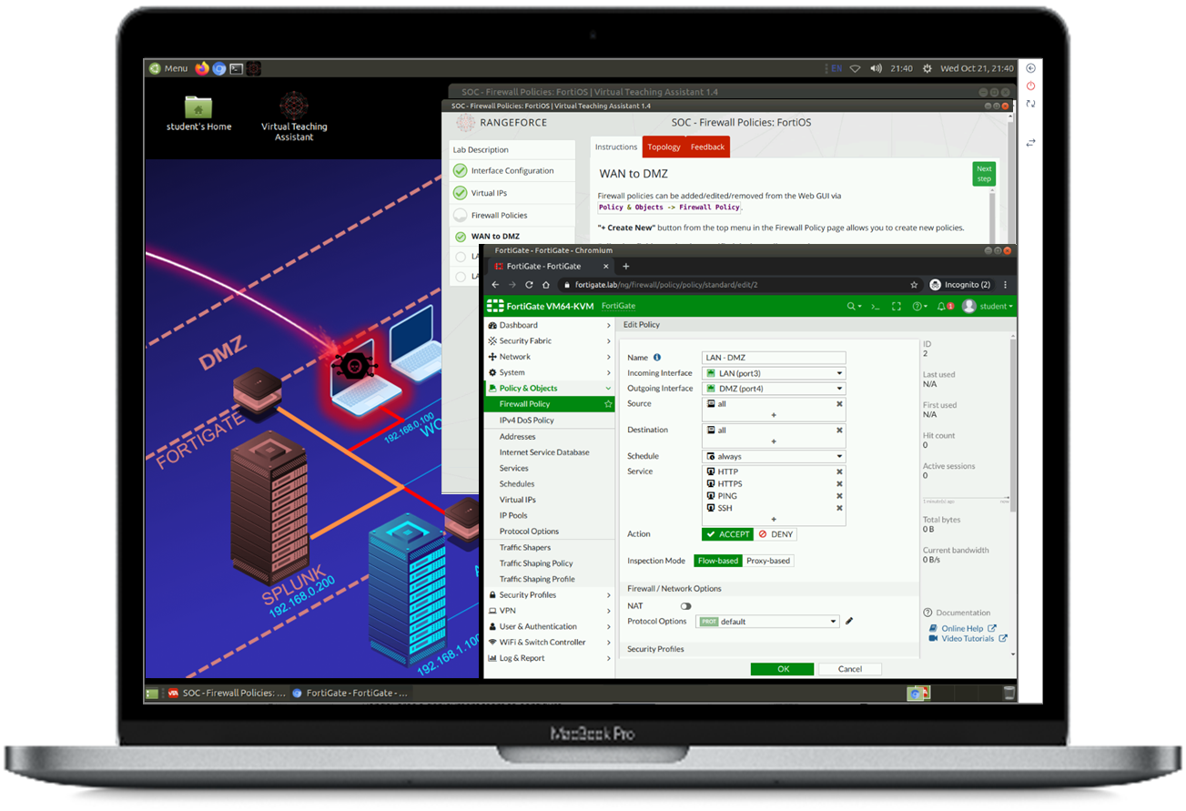
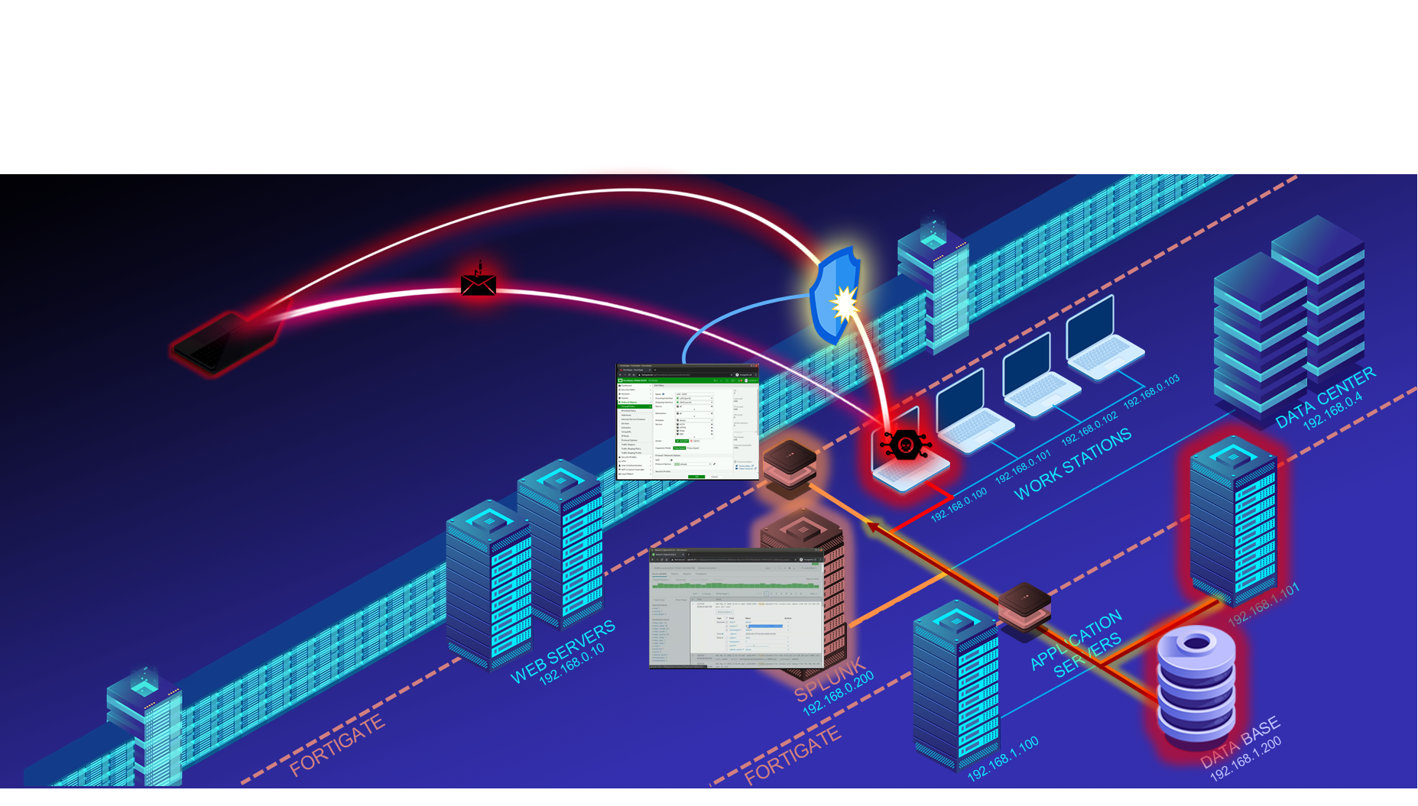
Battle Skills Individual Trainer
Self-Paced 100% hands-on individual training & challenges
350+ hours of individual training modules: Includes eight role-based Battle Paths, including SOC Analyst 1, SOC Analyst 2, Threat Hunter, and more.
Gamified: Problem-based, instant feedback, leaderboards.
Intelligent Teaching Assistant: Support, hints and advice when needed in order to master complex subject matter.
Individual Challenges: Assess each person's skills and learning for benchmarking and training plan development.
Battle Fortress Team Trainer
Hyper-Scalable Cloud Based Cyber Range (more)
Fast and easy to deploy: Cloud based emulation environment built on a highly scalable architecture.
Realistic: Includes real malware, real vulnerabilities, real infrastructure, and real users all in real-time.
Powerful emulation: Deploy and operate on your security stack in realistic IT environments.
Reusable Red and Blue Team exercises: Build from RangeForce’s library of attack vectors.
Exercise Attack Vectors:
Compromised Credentials
Lateral Movement
- Phishing/Spear Phishing
- Denial of Service
- Misconfiguration (multiple)
- Malware (multiple)
- Ransomware
- Encryption Defeated

Slide 6
RangeForce Battle Fortress Cyber Range
RangeForce Battle Fortress is a hyper-scalable cloud-based cyber range that enables the execution of red/blue team exercises in a realistic environment.
Fast and easy to deploy
Cloud based emulation environment built on a highly scalable virtual architecture
Includes RangeForce’s library of red and blue team exercises
Realistic
Battle Fortress includes real malware, real vulnerabilities, real infrastructure, and real users all in real-time
Powerful emulation capabilities means you train on your security stack in similar IT environments
Develop teamwork
Battle Fortress enables security teams to train together, acting in their roles, building stronger communications skills and teamwork
Refine incident response workflows
Practice detection and response processes against real attacks to increase response speed and accuracy
Continuous training
Post exercise results define new learning paths to address skills gaps and deficiencies

Slide 7
Battle Fortress Cyber Range – How it Works
Battle Fortress recreates realistic environments including malware and vulnerabilities. Software tool emulators bring vendor security stacks to life. Attack scenarios are unleashed on the exercise participants and they must work together to detect, contain and remediate the attack.
Adversary delivers a spear phishing attack. Infects a workstation with a malware backdoor.
Malware executes, take over the workstation and calls back to the C2 machine.
Adversary takes control of the machine, works to escalate privileges.
Adversary is able to dump local credentials and begin lateral movement
Credentials are used to access files shares, databases – files are moved for exfiltration.
2
1
4
3
3
5
4
1
2
Sensors and logs capture IOCs, and Blue Team SIEM operator receives first set of alerts.
Alerts are sent out, response playbooks begin executing.
Blue Team must find and correlate multiple IOCs to recognize exfiltration events, identify C2 attack vector.
Blue team defeats attack by deploying firewall rule changes, and identifying and isolating infected machine

Slide 8
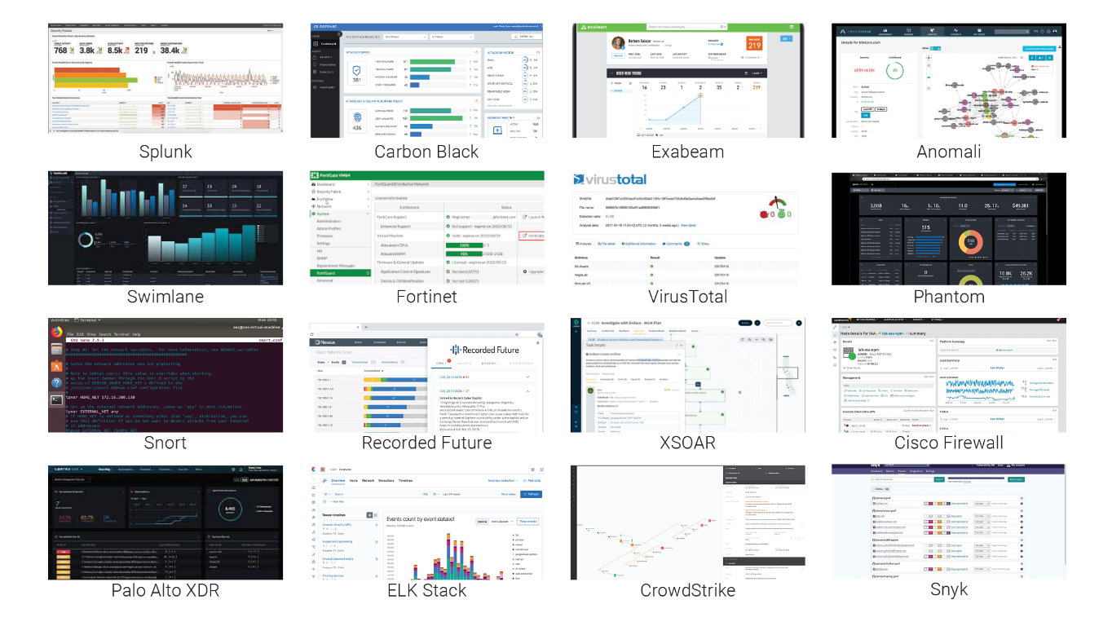
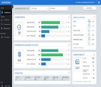
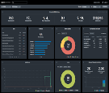
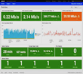
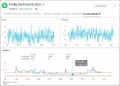
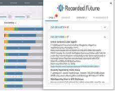
RangeForce Battle Fortress Plug and Play Security Stack Emulation
Build your virtual environment to include your security stack.
Virtualized Security Solutions
Your Security Stack
Carbon Black
Phantom
Splunk
Fortinet
Recorded
Future
…and more

Slide 9
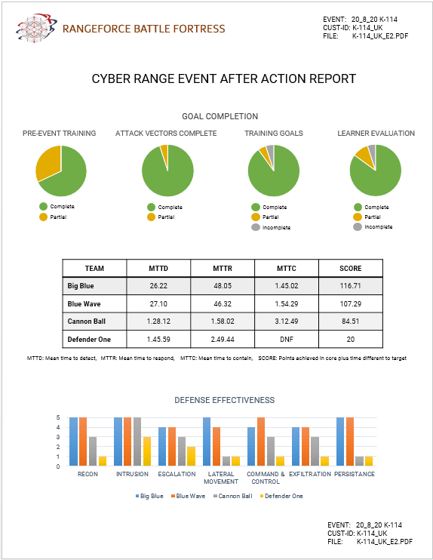
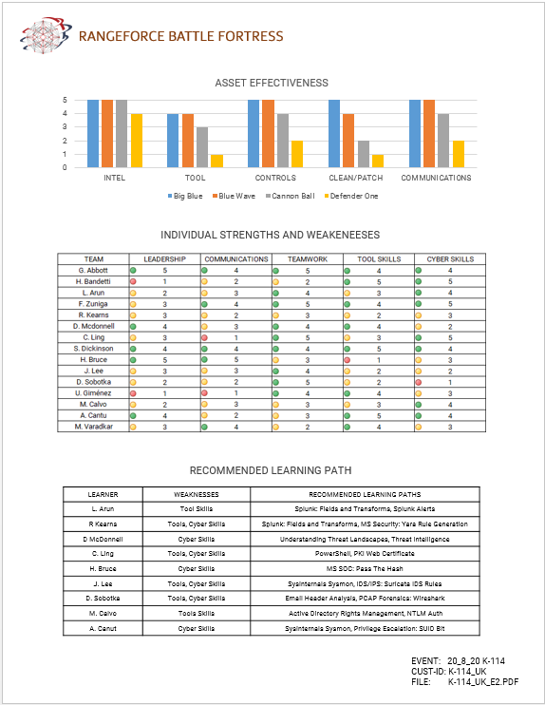
Battle Fortress After-Action Report

Slide 10
RangeForce Battle Fortress Exercise Timeline
1) Exercise Definition
Define the type of exercise, number of teams, goals of the exercise
Select from RangeForce’s library of exercises, environments, and security tools
Work with RangeForce consultants to scope exercise customization
3) Execute Battle/Blue Team Event
RangeForce training experts will remotely administer and support the exercise
Exercise will include leaderboards and RangeForce support across all stages including live monitoring and troubleshooting
Week 1
Week 2&3
Week 4
Week 5
2) Build Battle Exercise
RangeForce will build out your cyber range and create a scenario playbook defining entire exercise plan
RangeForce will deliver guidance on pre-exercise training and qualifications
4) Post Exercise
RangeForce trainers will debrief with all participants at the end of the exercise
RangeForce will provide a custom set of reports for all participants and teams
RangeForce will include post event training recommendations for all participants based on the strengths and weaknesses

Slide 11
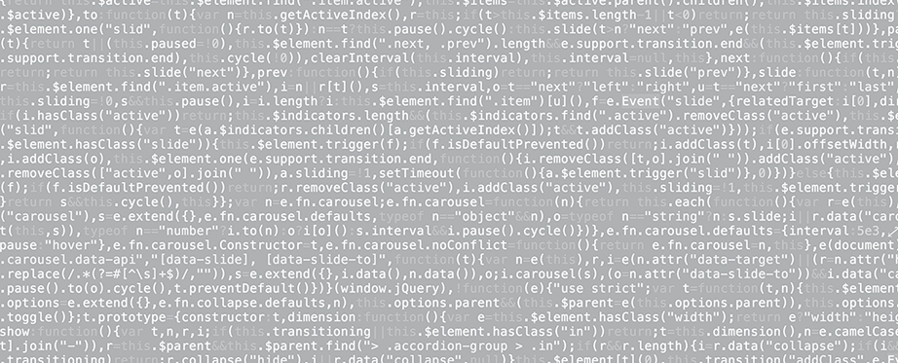

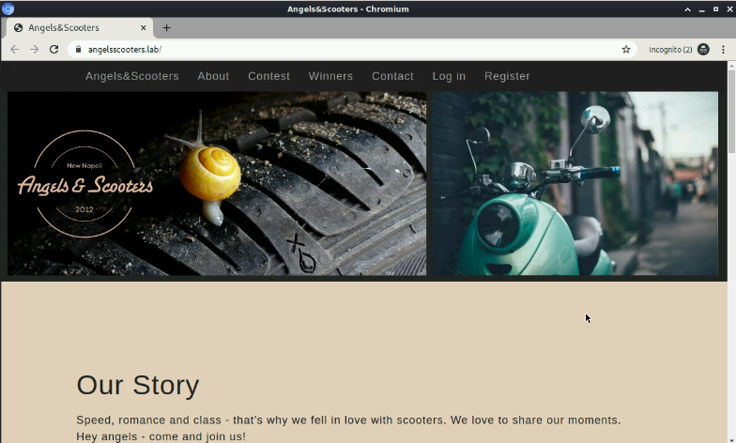
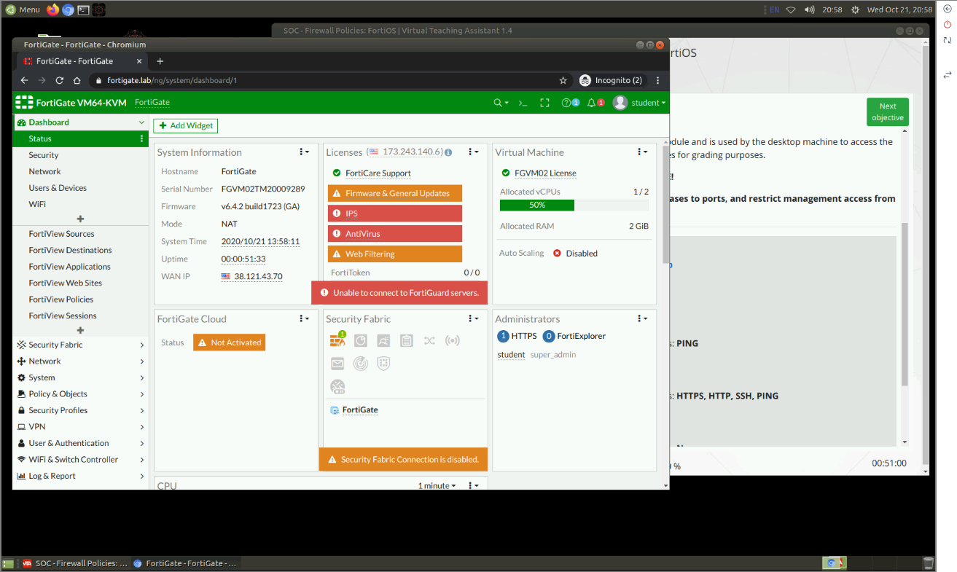
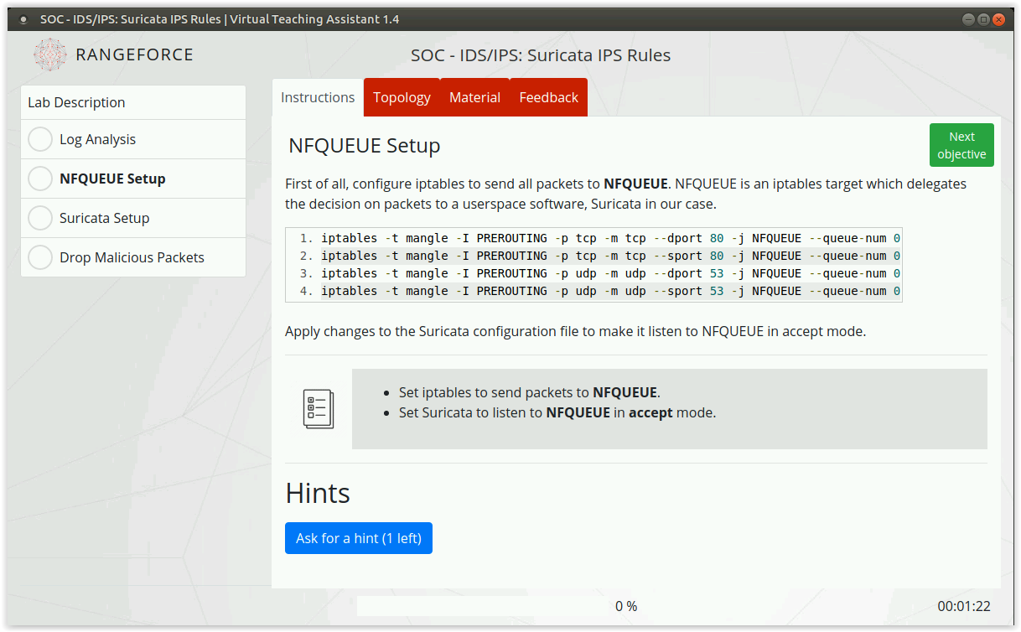
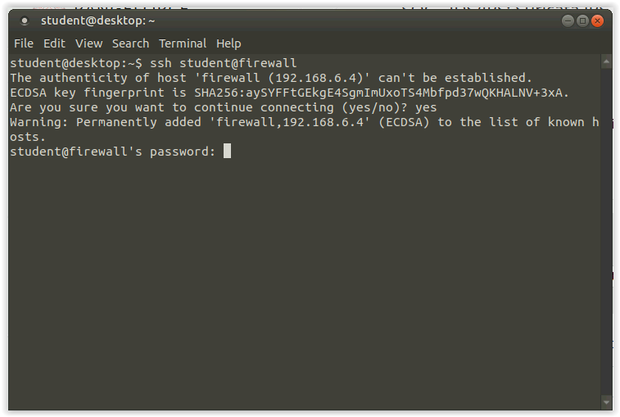
Integrating Training & Simulation in a Single UI
RangeForce Battle Skills combines eLearning, hands-on simulation, and live security tools to optimize retention and build muscle memory. Our modules and simulations can be practiced repeatedly, at the learner’s convenience.
Notes:
Note – this slide is to show the integration of the lesson plan, the simulation, and the hands-on training in a single UI.

Slide 12



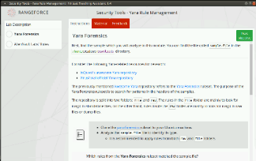
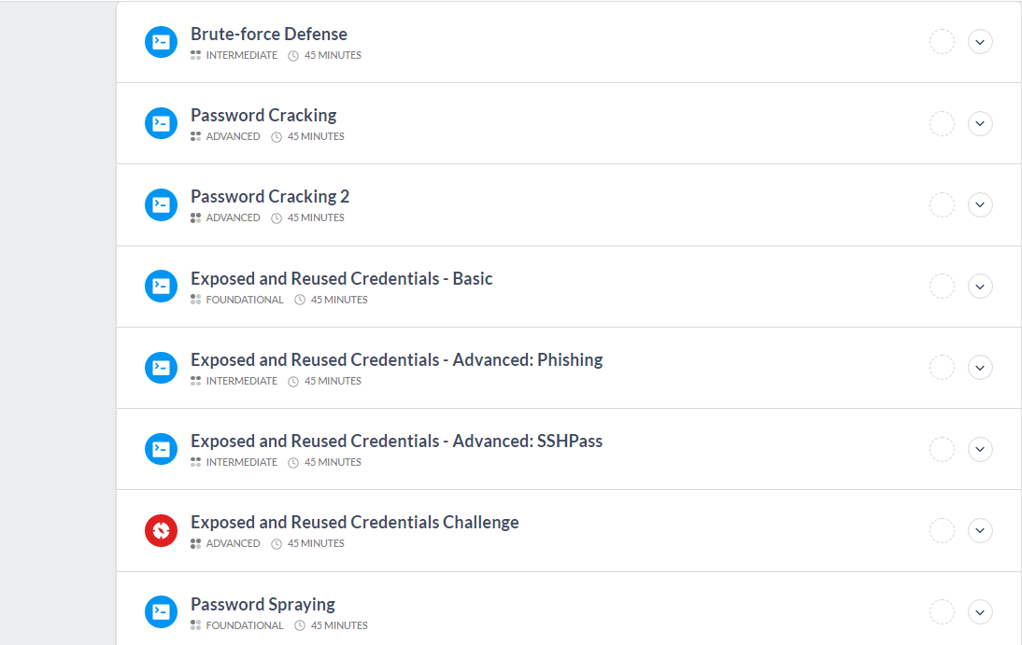
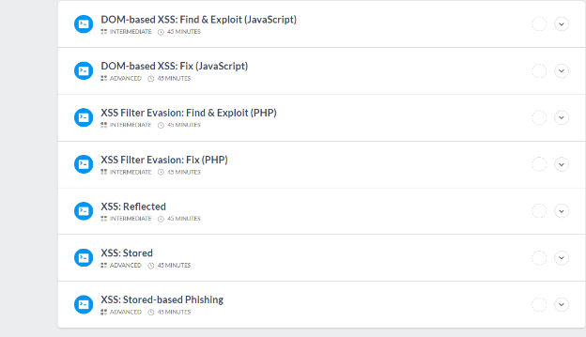
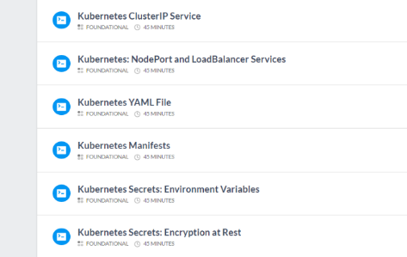


SOC/ Incident Response
Latest Vulnerabilities and Attacks: Weekly release of new modules covers latest CVE’s, malware, and attack methodologies.
Benchmark against: MITRE ATT@CK, NIST/NICE and NIST-CFS.
Prescriptive Learning Paths: SOC 1, SOC 2, Microsoft Security Core, and Threat Hunter.
Web Application Security
Secure code creation: with training focused on web application developers, architects, pen testers and QA teams.
Benchmark against: OWASP Top 10 vulnerabilities
Prescriptive Learning Paths: Application & Web App Security Core, Penetration Tester.
Cloud-Sec/DevSecOps
Build a culture of security: Training modules drive proper code hygiene and risk awareness for IT, Ops, and Dev.
Benchmark against: NIST-CFS
Prescriptive Learning Paths: Container Security Core, Linux OS Security Core, Microsoft OS Security Core

Slide 13

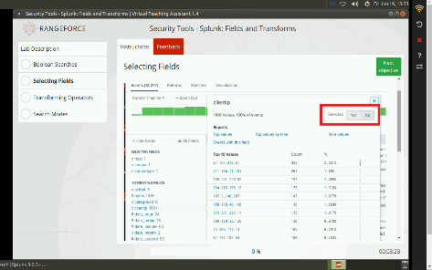
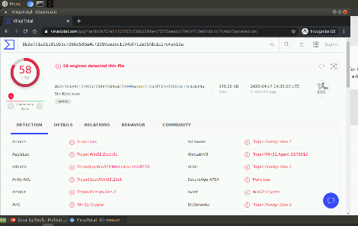














Vendor Tool Integration
Open Source Tool Integration

Slide 14

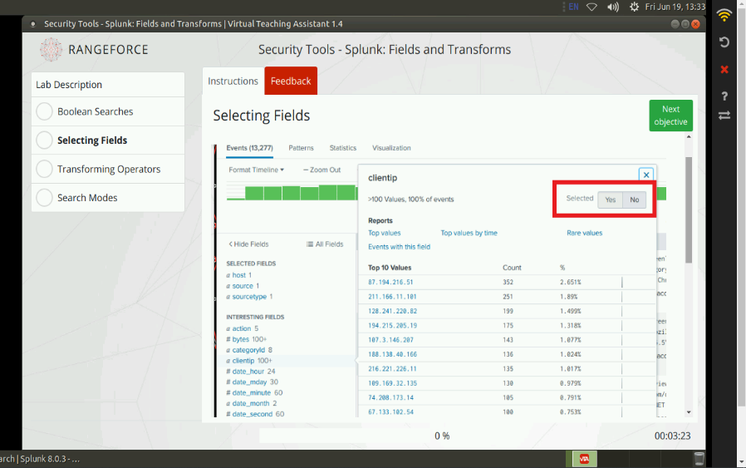


Slide 15
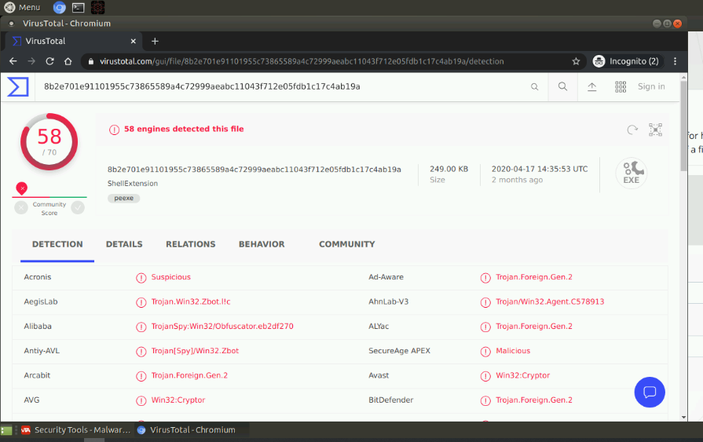


Slide 16
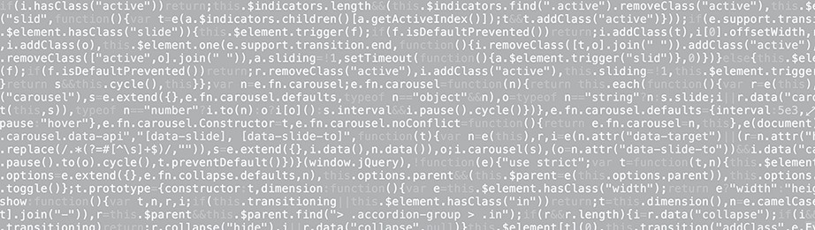





RangeForce Continuous Training
Mission
Ready
Individual
Assessment
Role-Based Battle Path
Individual Training
Individual Challenges
Team Exercises
Team Assessments
Threat Hunter
Web Application Security
Secure Coding
Security Analyst 2
Security Analyst 1

Slide 17
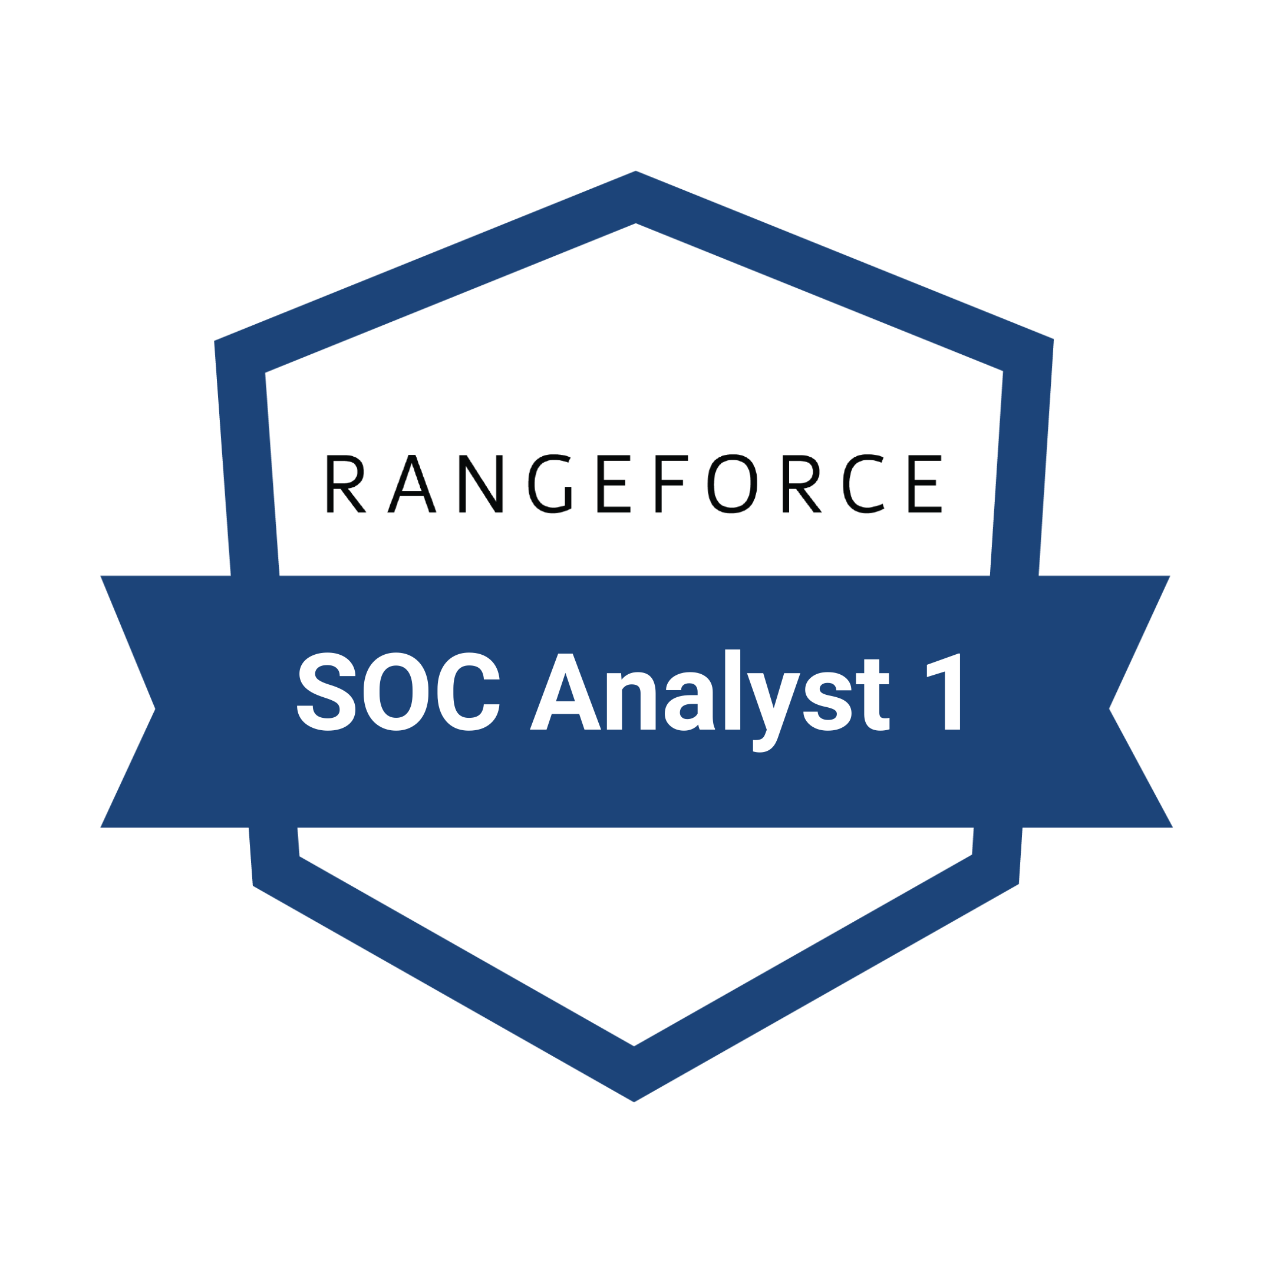

RangeForce Battle Paths
Battle Paths are prebuilt training programs that align to specific cybersecurity roles. When learners complete Battle Paths, they earn RangeForce Badges to validate and promote their skills. With the completion of select capstone challenges, learners can also claim RangeForce Elite Badges.
SOC Analyst 1
SOC Analyst 2
Threat Hunter
Secure Coding
Web Application Security (OWASP)
Cloud Security
Microsoft Core Security
Cybersecurity Essentials

Slide 18
Battle Path: SOC Analyst 1
The SOC Analyst 1 Battle Path enables cybersecurity professionals and students to gain live-environment experience with the foundational concepts and practices of a security operations center (SOC). Whether it’s understanding event logs, visualizing data, or conducting malware analysis, this curriculum is designed to get you SOC-ready. Work through a series of hands-on modules and related challenges to complete this path.
Prerequisites: Windows and Linux fundamentals, CLI experience
SOC Analyst 1 | Battle Path Overview
Course 1
Introduction to the SOC
Linux Syslog
Windows Event Logs
Course 2
Understanding the Threat Landscape
Splunk: Basics
Splunk: Fields and Transforms
Course 3
Malware Analysis Introduction
YARA Overview
Email URL Analysis
Course 4
Email Header Analysis
Wireshark Basics
Email Challenge
Course 5
Introduction to RegEx
Recorded Future:
Browser Extension Splunk: Visualizations
Course 6
YARA: Rule Generation
YARA: Rule Management
Splunk: Alerts
Course 7
Suricata: Basics
YARA Rule Writing
Threat Intel Challenge
Course 8
Suricata: Rule Management
Suricata: IDS Rules
Windows Procmon
Course 9
Malware Analysis: VirusTotal
Privilege Escalation Introduction
Remote Code Execution Introduction
Course 10
Pass the Hash
Linux System Info Gathering
Regular Expressions: Basic

Slide 19
Battle Path: SOC Analyst 2
The SOC Analyst 2 Battle Path is a great resource for entry-level analysts looking to take their career to the next level. In this path, you’ll work through hands-on modules to develop robust skills, including more sophisticated search capabilities, utilizing APIs and SIEMs to automate repetitive tasks, and incorporating the right tools into incident response. During our course challenges, you’ll demonstrate the resilience you bring to teams by applying your skills to incident response.
Prerequisites: Experience with SIEMs, signature-based detection, and basic data analysis.
SOC Analyst 2 | Battle Path Overview
Course 1
AD Rights Management
PCAP Forensics: Wireshark
Suricata: IPS Rules
Course 2
PCAP Forensics 2
Visual Spoofing
Basic Shell Scripting
Course 3
PowerShell Basics 1
Investigations with Wireshark
Suricata Challenge
Course 4
PowerShell Basics 2
Active Directory GPO
LOKI IOC Scanner
Course 5
Linux Log Management: Systemd Journal
Splunk: API
Identifying Linux IOCs
Course 6
AD Rights Management
PCAP Forensics: Wireshark
Suricata: IPS Rules
Course 7
Firewall Policies: FortiOS
Lateral Movement Overview
Greenbone Vulnerability Management
Course 8
PowerShell Logging
Splunk: Input Configuration
Botnet Takedown Challenge
Course 9
Windows NTLM
Process Injection IR with Splunk
CVE-2019-15107 WebMin Unathorized
Course 10
OpenSCAP
Sudo Killer
Traffic Light Protocol Overview

Slide 20
Battle Path: Web Application Security (OWASP)
The Web Application Security (OWASP) Battle Path is critical training for any application engineer mastering the skills needed to eliminate the most common application vulnerabilities. Supporting a "shift-left" development strategy, our training covers all ten of the OWASP vulnerabilities through hands-on, interactive training. By completing this training, you’ll demonstrate your ability to apply key web application security principles to real world uses.
Prerequisites: Experience with web coding concepts like PHP or java and familiarity with web application debugging tools
Web Application Security | Battle Path Overview
Course 1
Command Injection Fix
NoSQL Injection Fix
SQL Injection: Authentication Bypass
Course 2
Password Cracking
JSON Web Token Security
JSON Web Token Security Challenge 1
Course 3
HTTPS Security Introduction
API Security: Exposed Tokens
Wireshark Basics
Course 4
XML External Entities (Java)
Blind XML External Entities
XXE RCE Using PHP Expect
Course 5
Insecure Direct Object References 2 Fix
Path Traversal Fix (NodeJS)
Path Traversal Fix (PHP)
Unrestricted File Upload Fix (PHP
Unrestricted File Upload Fix (NodeJS)
Course 6
Cookie Security: HttpOnly: Fix (NodeJS)
Cookie Security: HttpOnly: Fix (PHP)
Cookie Security: Secure: Fix (NodeJS)
Cookie Security: Secure: Fix (PHP)
Privilege Escalation: Overprivileged Process
Course 7
DOM-based XSS Fix (JS)
Reflected XSS
XSS Filter Evasion Fix (PHP)
Course 8
Insecure Deserialization (Java)
PHP Serialization
PHP Serialization Challenge
Course 9
Linux Software Management
CVE-2019-15107 WebbMin 1.890 Exploit Unauthorized RCE
CVE-2017-5638 Apache Struts
Course 10
Linux Log Management: Systemd Journal
Splunk Webapp IR: Brute Force Detection
Insufficient Loggings: Injection Vulnerabilities

Slide 21
Battle Path: Threat Hunter
The Threat Hunter Battle Path is our most advanced blue team training for those who have mastered enterprise security operations. In this path, we’ll introduce you to the practices and techniques employed by attackers, from the tools at their disposal to the way they view and target systems. Exercise your threat hunting skills in the cyber range through a variety of interactive challenges that are designed to give you a better understanding of targeted attacks. Before starting your Threat Hunter journey, it’s suggested that you first complete our SOC Analyst 1 and SOC Analyst 2 Battle Paths.
Prerequisites: Experience with data collection, vulnerability scanning, and advanced incident handling.
Threat Hunter | Battle Path Overview
Course 1
Yextend
Malware Analysis Introduction
Linux Advanced Logging
Course 2
Password Cracking
Identifying Network IOCs: DNS Tunneling
IOC Challenge
Course 3
Netcat Introduction
Adv. Privilege Escalation: Exposed and Reused Credentials
Detecting Privilege Escalation
Course 4
Metasploit Basics
Reverse Engineering 1
Proxychains
Course 5
Reverse Engineering 2
CVE-2020-7247 OpenSMTPD RCE
Exposed and Reused Credentials Challenge
Course 6
CVE-2019-5736 Docker RunC Container Escape
Keys to Useful Threat Intelligence
Finding Patterns with YARA
Course 7
Suricata Challenge
Obfuscation Challenge
Malware Cleanup Challenge
Course 8
Splunk Lookups
Splunk Input Configuration
Linux Security Investigation Challenge
Course 9
Web App Exploit Challenge Delta 1
Web App Exploit Challenge Delta 2
Web App Exploit Challenge Delta 3
Course 10
SSH Backdoor Challenge 1
SSH Backdoor Challenge 2
SSH Backdoor Challenge 3

Slide 22
Battle Path: Microsoft Core Security
The Microsoft Core Security Battle Path is designed to sharpen your skills in Microsoft products. If you’re just getting started for the first time, this Battle Path will introduce you to key aspects of managing and defending a Windows environment. Gain a working understanding of Active Directory and Group Policy, learn to analyze Windows event logs, and practice common security tasks you can use on the job. Apply your skills through relevant challenges, including how to investigate malware on a Windows computer.
Prerequisites: Experience with Windows CLI and a basic understanding of OS operations
Microsoft Core Security | Battle Path Overview
Course 1
Windows Event Logs
Active Directory Rights Management
Active Directory GPO
Course 2
Windows Event Logs
PKI Web Cert Template
PowerShell Introduction
Course 3
PowerShell Basics 1
PowerShell Basics 2
PowerShell Code Signing
Course 4
PowerShell Logging
Regular Expressions: Basics
Sysmon
Course 5
Voidtools Everything
NTLM
Pass the Hash
Course 6
Windows: Weak and Reused Creds
Sysmon: Process Injection
Windows Information Gathering
Course 7
PKI Web Server Cert Enrollment
Nmap: SMB Enumeration
Sysmon Capture Clipboard
Course 8
Windows: Email URL Analysis
Windows: Splunk Basics
Windows: Procmon
Course 9
Windows: Email Header Analysis
Windows: YARA Introduction
Windows: YARA Rule Writing
Course 10
Windows: YARA Rule Generation
Windows: YARA Rule Management
Windows: Process Injection IR with Splunk

Slide 23
Battle Path: Cybersecurity Essentials
The Cybersecurity Essentials Battle Path emphasizes foundational components of security. Develop a clear understanding of key concepts and practices without diving into too much complexity. This path also covers topics across your security program, including business continuity and networking. Cybersecurity Essentials is a great starting point for aspiring cybersecurity professionals or those looking to expand their capabilities within a small or medium-sized organization.
Cybersecurity Essentials | Battle Path Overview
Course 1
Introduction to Cybersecurity/ Terminology
History of Cybersecurity
Cybersecurity Teams
Course 2
Understanding the Threat Landscape
Firewall Overview
IDS/IPS Overview
Course 3
Endpoint Protection Platforms Overview Endpoint Detection and Response
Server Protection Overview
Course 4
Logging Overview
Windows Event Logs
Linux Syslog
Course 5
Introduction to the SOC
Blue Team Function and Tasks
Red Team Function and Tasks
Course 6
Understanding the Cyber Kill Chain
Introduction to SIEM and SOAR
Security Topology
Course 7
Known vs. Unknown Malware
Ransomware Overview
CVE Overview
Course 8
Introduction to OSI Networking Model
Layer 2 Networking
Layer 3 Networking
Layer 4 Networking
Course 9
Deploying Enterprise Endpoint Protection
Deploying Enterprise Server Protection
DevOps Security Overview
Course 10
Physical Security Considerations
Introduction to Governance, Risk, and Compliance

Slide 24
Battle Path: Cloud Security
The Cloud Security Battle Path prepares you to protect resources in the cloud. With the rapid expansion of public cloud environments and continued migration of applications and data, cloud security has never been more important. While third-party point solutions are easy to deploy, they present unique security challenges relating to their own configuration. Complete this Battle Path to better understand critical cloud security concepts, including the key technologies and features of public cloud environments.
Cloud Security | Battle Path Overview
Course 1
Cloud Security Overview
Shared Responsibilities
IAM Overview
Course 2
IAM: Managing Users
IAM: Managing Roles
IAM: Strong Passwords
CASB Introduction
Course 3
IAM: Principle of Least Privilege
Data Deletion
Data Encryption
Access Control
Course 4
AWS Overview
AWS: IAM Stack
AWS: Enabling MFA
AWS: Enabling CloudTrail
Course 5
AWS: Deleting Account Access Keys
AWS: IAM Roles
AWS: IAM Policies
Course 6
Azure Security for the SOC
Azure: Understanding Attack Surface
Azure: Monitoring Cloud Processes
Course 7
Azure: Investigations in the Cloud Azure: Security Center Azure: Public Permissions
Course 8
Containing Lateral Movement in the Cloud
Isolating Attacks Cloud
Cryptomining Attacks
Course 9
Log Management using Splunk
Log Management using Qradar
Misconfigurations
Course 10
EDR in the Cloud
Hybrid Cloud Security Concepts
Cloud Governance, Risk, and Compliance

Slide 25
Battle Path: Secure Coding
The Secure Coding Battle Path provides a hands-on approach for addressing security and privacy throughout the entire software development lifecycle. You will learn about vulnerabilities that undermine security, including how to identify and remediate them in your own projects. This Battle Path is designed for software developers, testers, and architects who design and develop software in various programming languages and platforms, including desktop, web, cloud, and mobile. Secure Coding learners will improve their ability to deliver quality software that exhibits security and privacy as essential to its design.
Secure Coding | Battle Path Overview
Course 1
Identify Security Requirements and Expectations
Identify Factors That Undermine Software Security
Find Vulnerabilities in Your Software
Identifying Vulnerabilities in an Application
Cracking a Password Hash
Fixing a Password Hash Vulnerability
Gather Intelligence on Vulnerabilities and Exploits
Course 2
Preventing Software Defects
Assessing Application Functionality
Examining Source Code and Dependencies
Testing Attack Patterns
Handle Vulnerabilities Due to Human Factors
Handle Vulnerabilities Due to Process Shortcomings
Course 3
General Principles for Secure Design
Threat Modeling
Identifying and Ranking Threats
Identifying Countermeasures to Threats
OWASP Threat Dragon
Microsoft Threat Modeling Tool
Course 4
Common General Programming Errors
Buffer Overflow
Vulnerability Prevention Guidelines
Finding Common Web Vulnerabilities
Prevent Privacy Vulnerabilities
Course 5
Limiting Access
Bypassing Authentication and Authorization
Protect Data in Transit and at Rest
Implementing Encryption
Secure Error Handling and Logging
Practical Secure Logging
Course 6
Security Testing
Manual Code Review
Static and Dynamic Code Analysis
Linting Code
Automated Testing
Testing with OWASP ZAP
Course 7
Application Monitoring and Logging
Implementing Application Logging
Application Maintenance

Slide 26


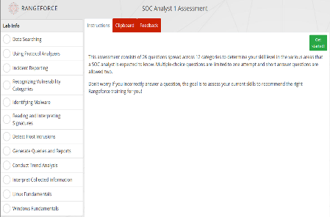

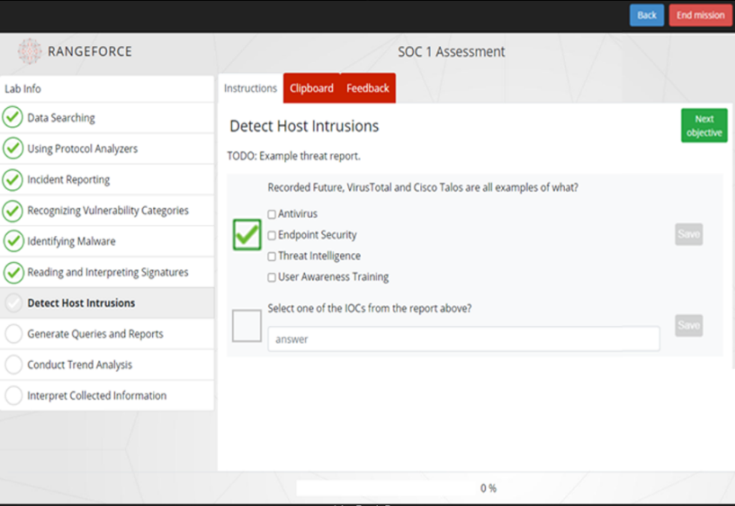
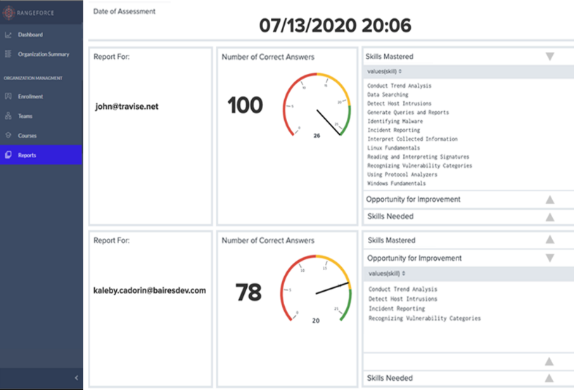
Role-based assessments
Rapid Evaluation: Understand an individual's strengths and weaknesses, quickly determine training needs and starting points.
Fast, light weight: Delivered through any browser, skills assessments are 15 minutes in length.
Skills report: Overall score for each learner and view of learner’s mastered, needs improvement, and missing skills.
Assessment Coverage: SOC Analyst 1, SOC Analyst 2, Threat Hunter, Application Security OWASP 10, Custom – based on needs.

Slide 27
Course & Modules Examples
SOC
WASE
DevOps
Security Basics For IT
Security Basics For All
Tools
Command Injection
DevOps
Cyber Concepts
Awareness
Virus Total
Recorded Future
Splunk
Suricata
Nikto
Nmap: SNMP Enumeration
NoSQLMap
PCAP Forensics
Find & Exploit (PHP)
Fix (PHP)
Module Tutorial
Web Hosting Basics (Apache)
File Management
Introductory Lab
Software Management
User Management
InfoSec Building Blocks
Introduction to the SOC
Introduction to SIEM & SOAR
Overview YARA
Overview Lateral Movement
Introduction to Email Threats
Overview IAM
Overview Ransomware
Overview Firewall
Overview Kerberos
Overview Traffic Light Protocol
Intro to Password Security
Intro to Password - Countermeasures
Overview BurpSuite Tools
Intro to Privileged Escalation
Autofill
Correct Links
Data Leaks
HTTPS
Keylogger
Malicious Attachments
Multifactor Authentication
Password Security
Popups
Ransomware
Social Engineering
Spear Phishing
Spyware
Unknown Networks
Unnecessary Data
Path Traversal
Find & Exploit (PHP)
Fix (PHP)
Find & Exploit (NodeJS)
Fix (NodeJS)
Operations
Docker
Botnet Takedown
Docker RunC Container Escape
Regular Expressions: Advanced
Regular Expressions: Basic
Regular Expressions: Intermediate
SQL Injection
Docker Dockerfile
Docker Introduction
Docker Networking
Authentication Bypass Union Select
Blind SQL Injection: Find & Exploit (PHP)
SQL Injection: Prelude
HTTPS
XSS
HTTPS Security: Apache
HTTPS Security: Introduction
HTTPS Security: Nginx
Escalations
XSS: Reflected
XSS: Stored
XSS: Stored-based Phishing
XSS Filter Evasion: Exploit
XSS Filter Evasion: Fix
Kernel Exploit (Dirty Cow)
LXD Group
Misconfigured PATH
SUID Bit

Slide 28


SOC Modules
SOC
Privilege Escalation
Challenge
Botnet Takedown
Docker RunC Container Escape
Regular Expressions: Advanced
Regular Expressions: Basic
Regular Expressions: Intermediate
Security Introduction
System Compromised
Docker Group
Kernel Exploit (Dirty Cow)
Linux Capabilities
LXD Group
Misconfigured PATH
SUID Bit 1
SUID Bit 2
SUID Bit 3
Wildcard Injection
Backdoor 1
Backdoor 2
Backdoor 3
Beta
Bulkhead
Daikon
Fl4gPrint3r
Grasshopper
Joker
OpenSMTPD
Privilege Escalation - SUID Bit
Uncontained
Webmin
Tools
Brute-force Defense
Malware Analysis
Nikto
Nmap: Basics
Nmap: SNMP Enumeration
Nmap: SSH Enumeration
NoSQLMap
Password Cracking
Password Cracking 2
PCAP Forensics
SSH-Audit
YARA Introduction
YARA Rules Management
YARA Rule Writing
YARA Advanced Rule Writing
IDS/IPS: Suricata Basics
IDS/IPS: Suricata IDS Rules
IDS/IPS: Suricata IPS Rules
IDS/IPS: Suricata Rule Management

Slide 29


Web App Security Modules
Command Injection
NoSQL Injection
Challenge
XSS
Find & Exploit (PHP)
Fix (PHP)
Injection 1: Find
Injection 1: Exploit
Injection 1: Fix
Injection 2: Exploit
Injection 2: Fix
Blind NoSQL Injection: Find & Exploit (Meteor)
Alpha LVL1
Alpha LVL2
Alpha LVL3
Delta LVL1
Delta LVL2
Delta LVL3
Delta LVL4
Gamma LVL1
Gamma LVL2
Gamma LVL3
JWT 1
JWT 2
JWT 3
Kappa
Phone
Spider
Atlantis
XSS: Reflected
XSS: Stored
XSS: Stored-based Phishing
XSS Filter Evasion: Find & Exploit
XSS Filter Evasion: Fix
DOM-based XSS: Fix (JavaScript)
DOM-based XSS: Find & Exploit (JavaScript)
Path Traversal
Find & Exploit (PHP)
Fix (PHP)
Find & Exploit (NodeJS)
Fix (NodeJS)
SQL Injection
Authentication Bypass Union Select
Blind SQL Injection: Find & Exploit (PHP)
SQL Injection: Prelude

Slide 30


DevOps Modules
DevOps
Docker
HTTPS
Module Tutorial
Web Hosting Basics (Apache)
File Management
Introductory Lab
Software Management
User Management
Docker Dockerfile
Docker Introduction
Docker Networking
HTTPS Security: Apache
HTTPS Security: Introduction
HTTPS Security: Nginx
Challenge
Linux CLI Fundamentals

Slide 31
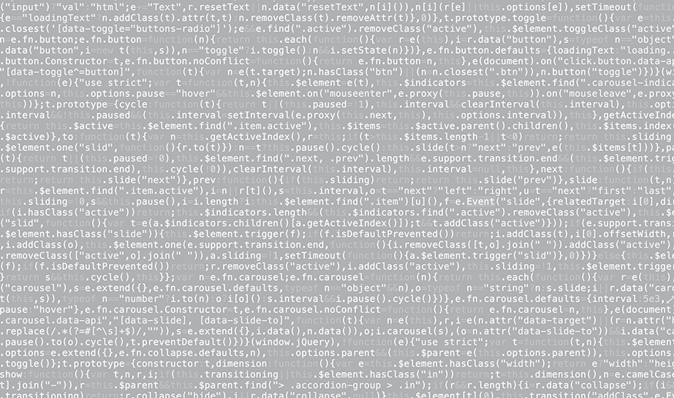


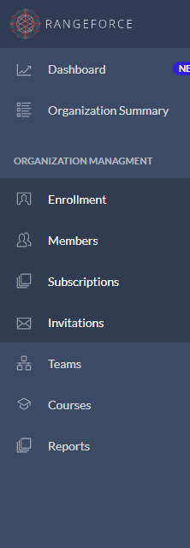

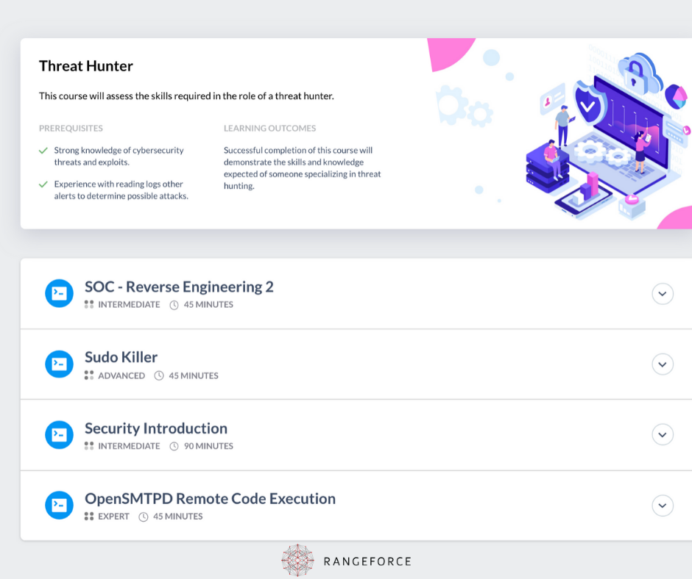

Slide 32

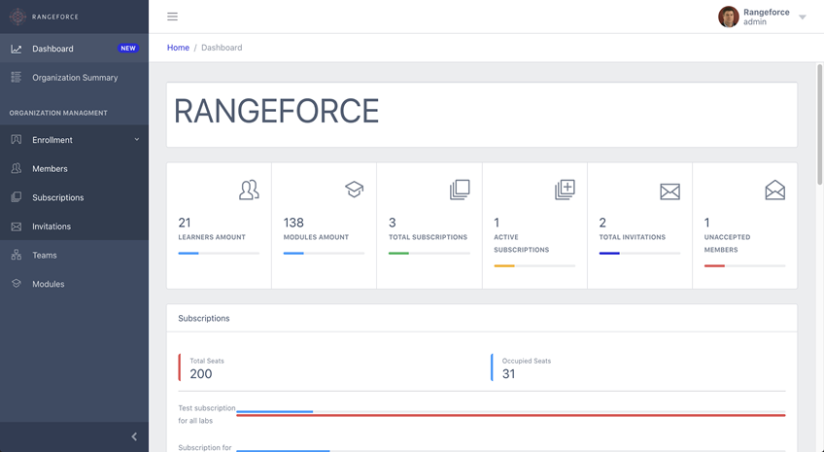


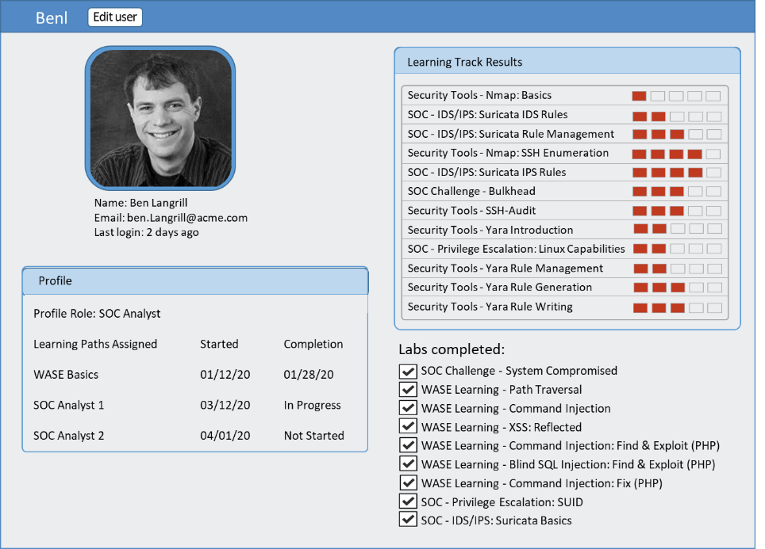

Slide 33

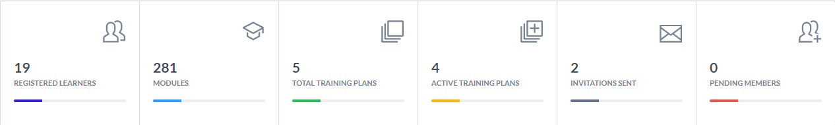
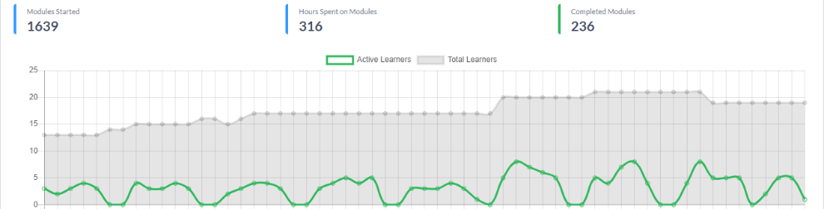

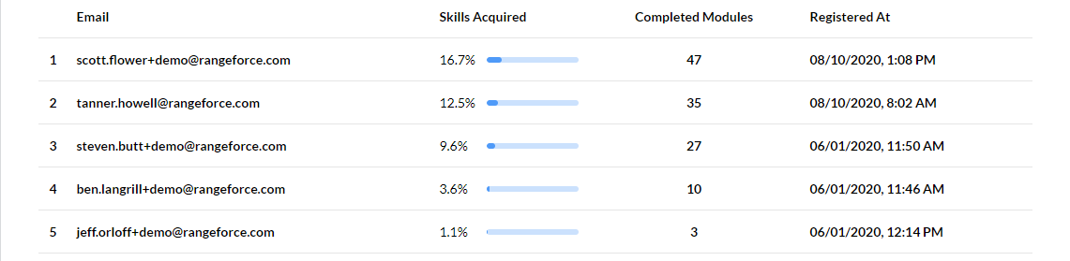

Slide 34




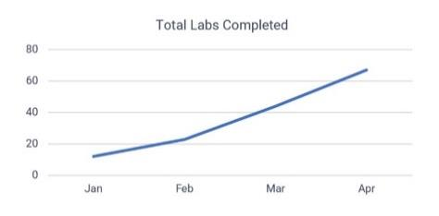
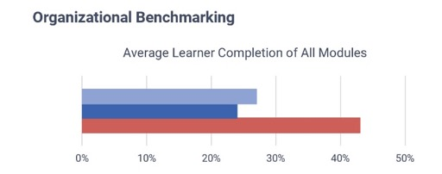
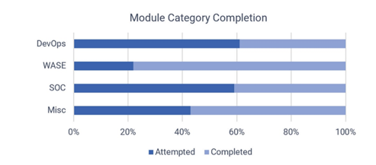
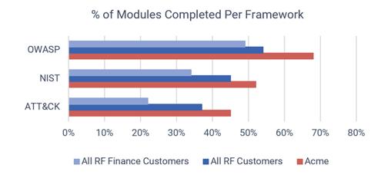
Acme Company April 2020
Executive Report

Slide 35






RangeForce Use Cases & Value
Build a Cyber Training Program
Visualize team strengths & weakness against NIST/NICE & MITRE ATT&CK
Set and report against individual and team annual training goals
Build team readiness, cyberattack resilience
Learn to Identify & Fix Vulnerabilities
Train Security, Web App, & DevOps teams to avoid coding errors
Integrate security hygiene into application coding
Build a security culture across IT & DevOps
Continually Hone Operational Expertise
Create prescriptive training paths
Train & test skills on the latest malware and vulnerabilities
Create cyber-experts
Assess Candidate Skills
Test candidates to ensure skills match role
Objectively identify best candidate fit for company
Reduce/eliminate bad hires
Identify Hidden Talent
Identify talent across IT & security staff
Cross-train and upskill employees
Increase effectiveness and value of team
Reduce Training & Hiring Costs
Save 65% over classroom training programs
Eliminate need for training travel costs
Eliminate need to rent/build a cyber range

Slide 36

Next Steps & Questions
Identify challenges that RangeForce can help solve
Identify key team members to set up a trial
Understand needs, timelines, and budget

Slide 37
Name
@rangeforce.com
Phone

Slide 38





Global Executive Team
Manassas, VA
USA Headquarters
Tallinn, Estonia
London, UK
Taavi Must
CEO, FOUNDER
Taavi has 20+ years of experience in cybersecurity and IT. He has delivered cybersecurity training to NATO, the Estonian Defense Forces, and Fortune 500 companies across Europe and the United States.
Gordon Lawson
CRO, PRESIDENT
Gordon was formerly SVP Sales at PhishMe (renamed Cofense) where he architected the go-to-market strategy and led the company’s commercial team from less than $5M to market leadership with a more than $100M revenue run rate.
Magnus Ernitis
CTO, FOUNDER
Sam Hahn
VP, FINANCE
Jaanus Kink
COO, FOUNDER

Slide 39




2017 Data Breach
Attack Methods:
Web App vulnerability scanning and exploitation
Access database credentials, escalate privileges, compromise more logins
Establish persistence through multiple backdoors
Extract data
May 13
July 29
July 30
September 7
Breach began
Breach discovered
Breach shut down
Breach announced to the public
44% of the U.S. population impacted
RangeForce Training Modules:
AppSec- API Security
AppSec- JSON Web Token Security
SOC - Privilege Escalation
SOC - IDS/IPS: Suricata Basics
AppSec - XSS Filter Evasion: Find & Exploit
Security Tools - Nikto, ZAP, Nessus, and ELK
8,000
Canadian citizens exposed
Assessments:
SOC Challenge – Backdoor Attack
AppSec Challenge - JSON
147.9 Million
U.S. citizens exposed

Slide 40
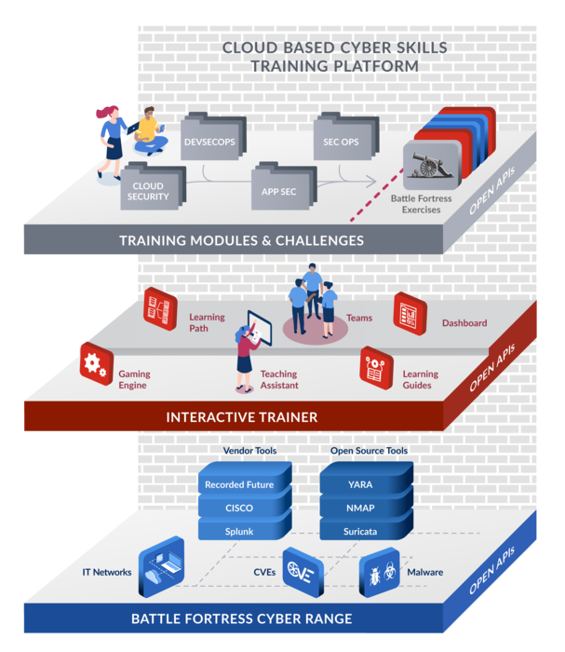

RangeForce Platform & Packaging
The RangeForce CyberSkills Platform is the descriptor of our overall architecture. It can be broken down into three groupings of capabilities
RangeForce Cyber Range which creates the highly realistic training environments found in all of our hands-on modules, challenges, and blue/red team exercises.
RangeForce Interactive Training which encompasses all of the features and capabilities related to interacting with and managing of the learners working in our system. It also includes the administrative features of our platform
RangeForce Training Modules, Challenges, and Exercises. This is all of the content that we offer. It includes individual training and challenges as well as team training and challenges.
The RangeForce CyberSkills Platform is sold in two different packages or combined as an enterprise package.
RangeForce Battle Fortress
Team Trainer
Battle Fortress is the RangeForce Team Trainer. It consists of the Range Force Cyber Range, Blue & Red Team Exercises, and the Battle Fortress specialty interfaces including scenario builder, exercise game play, and after action reporting.
It DOES NOT include individual training/challenges, learning paths, learning guides, teaching assistant, and the core Battle Skills management and reporting functions.
INTERACTIVE TRAINING & MGMT
RangeForce Battle Skills
Individual Trainer
Battle Skills is the Individual Trainer and includes all of the CyberSkills platform features.
It does not include Battle Fortress, Battle Fortress Exercise Mgmt., reporting or the actual team skills exercises.
CYBER RANGE

Slide 41

RangeForce Packaging
 | Battle Skills | Battle Fortress | Enterprise
Cyber Range | Yes | Yes | Yes
Security Training Orchestration | Yes | Yes (live tools only) | Yes
Virtual Teaching Assistant | Yes | No | Yes
Teaching Guides | Yes | No | Yes
Learning Paths/Certificates | Yes | No | Yes
Individual & Team Skills Dashboards | Yes | No | Yes
Interactive Gaming Engine | Yes | Yes | Yes
Individual Training Modules | Yes | No | Yes
Individual Challenges | Yes | No | Yes
Team Challenges | No | Yes | Yes
Exercise Design Console | No | Yes | Yes
Battle Fortress After Action Report | No | Yes | Yes
Certificate Training Accreditation | Yes | No | Yes
Award Micro-certificates & Badges | Yes | Yes | Yes

